Slide 1
Behavioral Economics and Risk Taking
17
Notes:
Pre-class music: ”The Gambler” by Kenny Rogers (See Tip #588)
You could relate the themes in this song to the section in this chapter on the role or risk in decision making. You can also explain how certain rules of a card game might affect an individual’s decisions.
What rules are necessary for markets to work well?
The key concepts covered in this song are:
Behavioral economics
The firm
Property rights
Markets
Shutdown decision
Another song you could play before beginning your lecture on behavioral economics and risk taking is Metallica’s “Master of Puppets (See Tip #591)
You can then ask students why they think someone would continue to engage in behavior that is self-damaging? Do they think addiction is rational? These questions will be explored further in an Economics in the Media slide.
The key concepts covered in this clip are:
Elasticity
Behavioral economics
Perfectly inelastic demand
Utility

Slide 2
Previously—1
Due to diminishing marginal utility, the amount of happiness gained from additional consumption will get smaller and smaller.
When maximizing utility, consumers face a budget constraint, which depends on income and prices.
In order to maximize utility, a consumer will buy goods that give her the largest marginal utility per dollar–“bang for the buck.”

Slide 3
Previously—2
At the consumer optimum:
A change in the price of a good has both a substitution effect and a real-income effect.

Slide 4
Let’s Play a Game—1
Before we begin: I am going to give some of you a chance to win some real money–up to $10!
There are two roles in this game: a Proposer and a Responder. You will get a chance to play both roles.
As the Proposer you decide how to split $10 with the Responder. You can offer them any amount of the $10, from $0 to $10 in 25-cent increments.
The Responder can either accept or reject the offer. If they accept the Proposer’s offer, the $10 is split accordingly. If they reject the offer, both get nothing.
Notes:
“Beyond the Book” Slide: The Ultimatum Game
Lecture tip:
The author of these slides usually plays the Ultimatum Game on the first day of class, but it will work here.
The amount to be split is $10, and you randomly draw three pairs of students to receive money. Depending on whether the offer is accepted or rejected, you are out anywhere from $0-$30.
Pass out index cards to the class.
Go over the game rules on this slide. It is a good idea to go over a few examples.
Collect the index cards from the left side of the room and the right side of the room. Keep them in separate stacks.
Pass them back, flipping the stacks.

Slide 5
Let’s Play a Game—2
On your index card, write:
I ____________ offer you __________ of the $10.
(last 4 digits of ID#)
Consider the offer you have received. Decide whether you wish to accept or reject. Then write:
I ____________ , ______________ your offer. (last 4 digits of ID#) (accept/reject)
Notes:
“Beyond the Book” Slide: The Ultimatum Game
Lecture tip:
After the Proposers have written their offers, collect the index cards from the left side of the room and the right side of the room. Keep them in separate stacks.
Then pass them back, flipping the stacks.
Tell them they now need to play the role of the Responder. Remind them what two choices they have.
Collect all the cards, shuffle them, have a student select three cards, and pay out money.

Slide 6
Let’s Play a Game—3
How does Homo economicus play this game?
How do Homo sapiens play this game?
Notes:
“Beyond the Book” Slide: The Ultimatum Game
Lecture tip:
This is covered later in the PowerPoint, so I would go over the main difference between how the two would play the game.
If you have time you could question students to see if there were any “strange” offers, for example, someone offering more than $5 or someone rejecting $5.

Slide 7
Big Questions
How do economists explain irrational behavior?
What is the role of risk in decision making?
Notes:
Lecture tip:
Emphasize that “irrational” is not used in the sense of crazy, nuts, etc.
We are trying to explain decisions people make that are not consistent with our rational choice model.
A rational individual strives to maximize the benefits received from each course of action while minimizing the costs.
We generally assume that people try to make themselves as happy as possible, but we now consider the ways in which people make mistakes in real-life decision making.
Rationality assumes that people never intentionally make themselves worse off.
We’ll discuss biases in which people accidentally make the “wrong” decisions.

Slide 8
Economics in This Is Spinal Tap
The band will have a little extra in reserve when they need to play louder.
Notes:
“Economics in the Media” Slide
Lecture tip:
The clip mentioned on the slide can be found in the Interactive Instructor’s Guide. Access the direct link by clicking the icon in the PowerPoint above.
The key concepts covered in this clip are:
Behavioral economics
Marginal utility
Rationality
What is irrational about the guitarist’s argument? Does relabeling a “10” to an “11” make the sound louder?

Slide 9
How Do Economists Explain Irrational Behavior?—1
Behavioral economics
  Field of economics that studies how human psychology influences decision making process
Bounded rationality
  Theory that argues that economic agents are only capable of making limited strategic decisions
  Incomplete information, limited brain power, not enough time
Notes:
Lecture notes:
Are we “robots” that just analyze decisions or are there some human limitations (frictions) in this process?
Rather than being “fully rational” we are “bounded rational.”
You may want to note here that this is a pretty old idea: Herbert Simon had it in the 1950s.
We still attempt to make the “best” decision, but our decisions are limited by the information available, our own cognitive ability, and the time we have to make the decision.
Ask students for some examples:
The textbook discusses a bride looking for a wedding dress.
Possible critique/extension:
Given that we are aware that our decisions are bounded, how/when do we adjust our decision making?

Slide 10
How Do Economists Explain Irrational Behavior?—2
What are some behaviors that do not fit assumptions about fully rational behavior?
  Misperceptions of probabilities
  Inconsistencies in decision making
  Judgments about fairness
Notes:
Lecture tip:
Set up this slide by asking students to list the misperceptions of probabilities.
Misperception: People put too much weight on low probability events; too little weight on high probability events
Inconsistencies: For example, people are subject to framing effects, change their minds when irrelevant alternatives are offered, suffer from status quo bias.
Fairness: not normally modeled in standard models
Next set of slides go over them in detail

Slide 11
Misperceptions: Games of Chance—1
Why do people play the lottery or gamble when there is little chance of winning?
Calculating the expected value of each gamble:
  You bet $10 that the flip of a coin turns up heads. If it does, you win $25.
  You buy a $1 lottery ticket with a current jackpot of $2 million. You have a 1:7 million chance of winning.
Notes:
Lecture notes:
Before answering the question on the slide, explain to students when it would make sense to take a gamble.
The expected value of the first gamble is positive: ½ x $25 = $12.50 > $10.
The expected value of the second gamble is negative: 1/7 x $2 = $0.29 < $1.
Would make sense to take the first gamble but not the second (note that the text must be assuming risk neutrality).

Slide 12
Misperceptions: Games of Chance—2
Why do people play the lottery or gamble when there is little chance of winning?
  Players have incomplete information or do not calculate the exact odds of winning.
  Players believe they have some control over the game–“lucky numbers.”
  Gambling is fun.
Notes:
Lecture notes:
Return to the initial question.
Do lottery players realize they have a very small chance of winning or that their numbers are really not “lucky?”
Note that if players get utility from gambling itself, then taking a gamble even when it has a negative expected value might be perfectly rational.

Slide 13
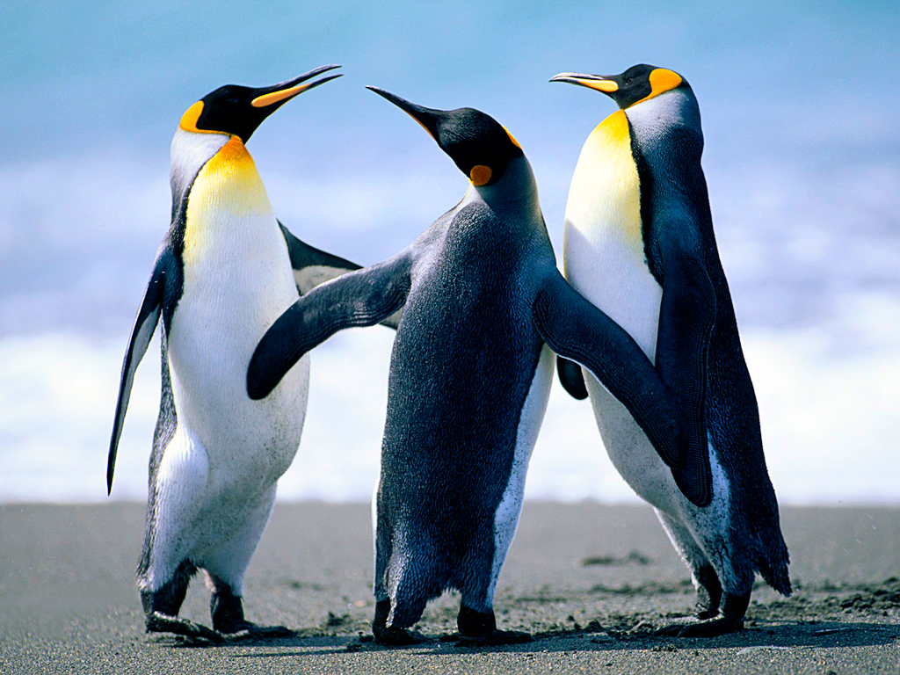
Misperceptions: Difficulty in Assessing Probabilities
Why do people drive yet refuse to fly?
Let’s Make a Deal
CURTAIN
1
CURTAIN
2
CURTAIN
3
Would you like to
switch to Curtain 2?
Your choice:
1/3 chance of
being right
Notes:
Lecture notes:
On driving yet refusing to fly:
Flying is roughly ten times safer than driving.
Let’s Make a Deal—First Click:
There are three curtains: Behind one curtain is a new car; behind another, a smaller prize; and behind the last curtain, three penguins.
Second click:
Given a choice of three boxes, you choose Curtain 3.
At this point you have a one-third chance of being right, and a two-thirds chance of being wrong.
Monty Hall opens Curtain 1 to show you the penguins.
Third click:
Opens Curtain 1 to reveal the penguins.
Monty then gives you a chance to switch your choice to Curtain 2.
Few contestants switch. They mistakenly believe that there is now a fifty-fifty chance of winning the car. They don’t switch because they don’t want to regret not sticking with their initial decision.
Why is their choice irrational?
The probability that the car is behind Curtain 2 is now two-thirds, not one-half, so given the odds, the contestant should switch.

Slide 14
Misperceptions: Seeing Patterns Where None Exist
Gambler’s fallacy
  Belief that recent outcomes are unlikely to be repeated and that outcomes that have not occurred recently are due to happen soon.
Hot hand fallacy
  Belief that random sequences exhibit a positive relationship.
Stock market
Notes:
Lecture notes:
Gambler’s fallacy:
If a coin is flipped and there are a large number of heads in a row, more likely that tails will occur next.
But the probability that a flipped coin turns up heads or tails on any flip is independent of what happened on previous flip.
Hot hand fallacy:
Opposite of the gambler’s fallacy.
In poker: A player wins several hands in a row, so believes that they will win again.
Basketball: Once a player has made several shots in a row, they are more likely to make another shot. One study found no correlation between success in one shot and the next.
Stock market:
Herd mentality: Investors more likely to buy (sell) when a stock is doing well (bad) even if no change in the underlying valuation: hot hand.
Yet some investors take contrarian position: If a stock has been doing really well, bet that it will start to go down: gambler’s fallacy.

Slide 15
Inconsistencies in Decision Making
Standard consumer choice models assume that preferences satisfy:
  Transitivity
    If apples are preferred to bananas, and bananas are preferred to oranges . . .
  Independence of irrelevant alternatives (IIA)
    Your choice should not change if an irrelevant alternative is added to your choice set.
Notes:
“Beyond the Book” Slide
Lecture notes:
An IIA Example:
You eat lunch at a local diner. The waitress says we have two sandwich specials today: a roast beef sandwich with a drink and chips or a turkey sandwich with a drink and chips.
You think for a moment, and order the roast beef.
As the waitress is about to leave with your order, she says: “Oh, I forgot, we also have a ham sandwich with a drink and chips.”
You reply, “Oh, in that case I will have the TURKEY sandwich.”
In this case, the ham sandwich is the irrelevant alternative since you did not choose it when it was introduced. But it should not have changed your original preferences of roast beef over turkey.

Slide 16
Inconsistencies: Framing Effects—1
Framing effect
  Occurs when people change their answer (action) based on how a question is asked
  People buy 95% lean ground beef, but not 5% fat ground beef
  Do you choose a risky medical procedure if told:
    90 percent are still alive after five years
    10 percent are dead after five years
Notes:
Lecture notes:
Framing:
People make different choices for the same choice problem when it is presented in different ways.
If people are rational, if the choice is the same, it should not matter how it is presented.

Slide 17
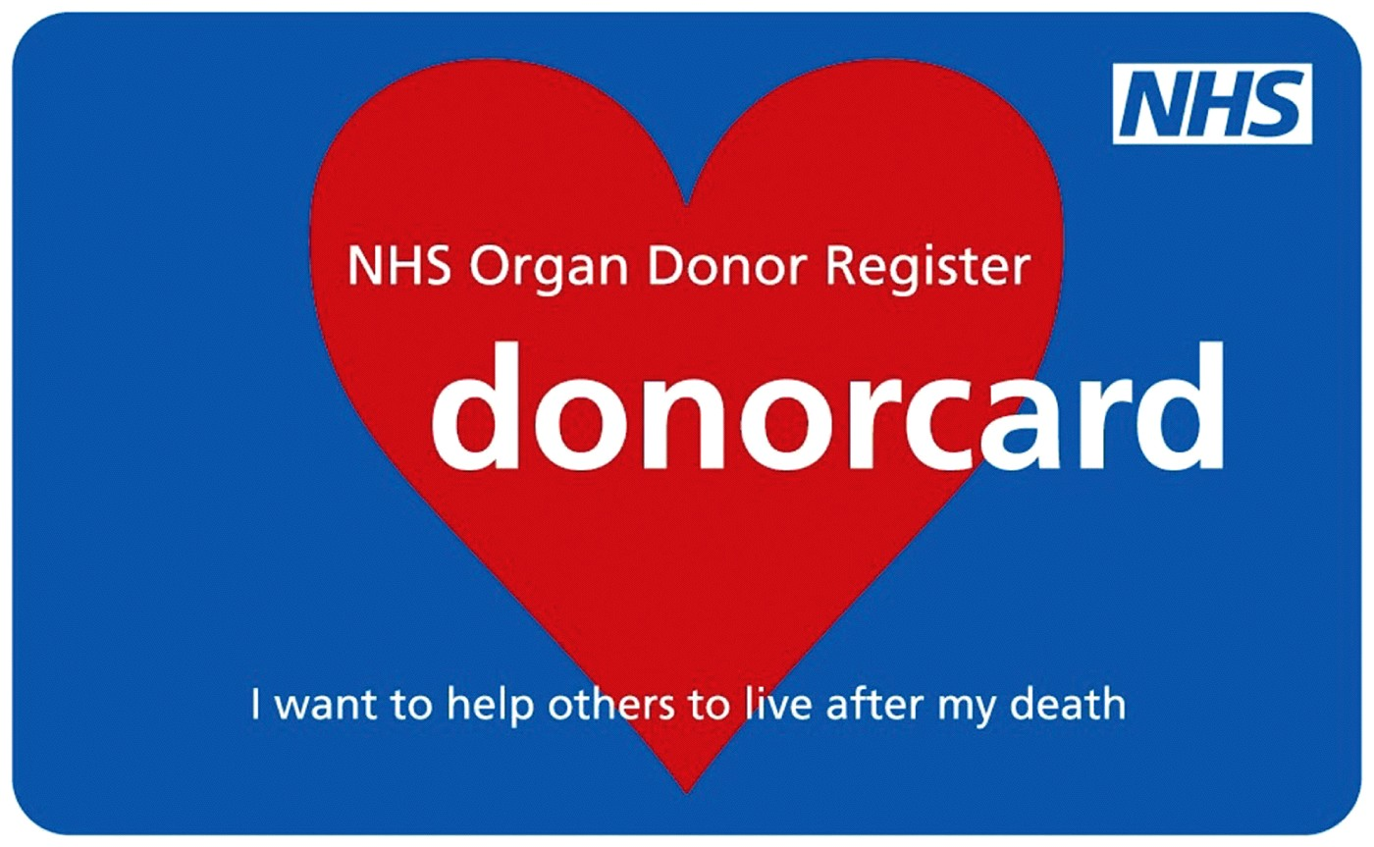
Inconsistencies: Framing Effects—2
Company 401K: Two possible options
  “Do you want to enroll in program?”
  “Do you want to opt out of automatic enrollment?”
Organ donation
  Which system, opt-in or
  opt-out donation, will have
  greater participation rate?
Notes:
Lecture notes:
Note that the textbook treats these examples as a framing effect problem. They are also good examples of the status quo bias, and default rules.
Company 401K:
How the choices are presented should have no effect on participation rates, but participation rates are lower if you actively have to join.
Organ donation:
With opt-in donation (United States) you have to actively do something to become an organ donor. With opt-out donation (European countries), you are assumed to want to be an organ donor, unless you actively do something to opt out.
All else being equal, donor rates should be the same across countries, but participation rates are much higher in opt-out countries.
[© Presselect / Alamy]

Slide 18
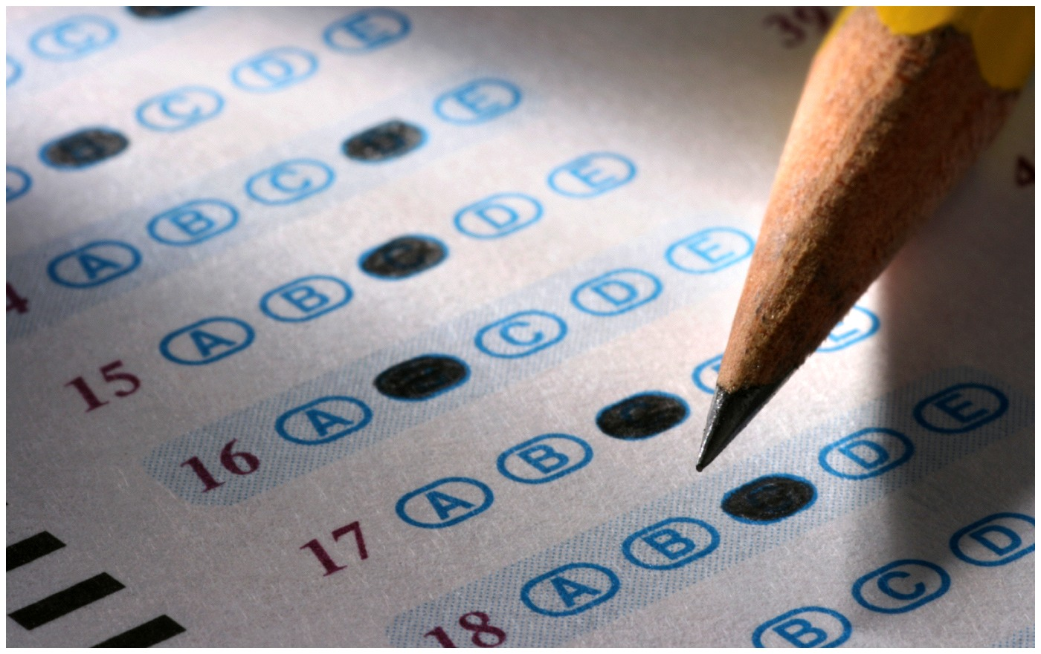
Inconsistencies: Priming Effects
Priming effect
  Occurs when the order of questions influences answers or choices
  “Are you happy?” and “How many dates this year?”
  Doing poorly on exams?
Notes:
Lecture notes:
On “happy” and “dates”:
Students who were asked “How many dates this year?” and then “Are you happy?” reported being happier (those who had dates) than students who were asked the questions in the reverse order.
On grades:
The order in which questions are asked shouldn’t matter, but it does. You have probably experienced both of these effects on exams. Poorly designed exams lead many students to give the wrong answer when they know the correct answer, whereas exams created with an understanding of framing and priming effects produce unbiased measures of student understanding.
[Ryan Balderas/iStock photo.com]

Slide 19
Inconsistencies: Status Quo Bias
Status quo bias
  Exists when decision makers want to maintain their current choices . . .
  even if a change would be preferred.
  Examples:
    New products
    $1 coins
    401K plans
    organ donation programs
    low-interest savings accounts

Slide 20
Economics in “The Marshmallow Test”
Could you wait five minutes to get an extra marshmallow?
Notes:
“Economics in the Media” Slide
Lecture tip:
Access the direct link to the clip mentioned on the slide by clicking the icon in the PowerPoint above.
Tempting little kids with marshmallows.

Slide 21
Inconsistencies: Intertemporal Decision Making—1
“Seemed like a good idea at the time.”
Intertemporal decision making
  Planning to do something over a period of time
  If rational, you value the present and the future consistently
What’s the problem for many of us?
  We tend to be impatient: overweigh today’s utility above tomorrow’s utility.
Notes:
Lecture tip:
Ask students whether they have done something that seemed like a good idea when they did it, but later, it turned out to be a bad idea.
This relates to hyperbolic discounting:
A steep drop in the weight you place on utility earned in future periods.
Or you overweight the benefits from acting today, and underweight the future costs.

Slide 22
Inconsistencies: Intertemporal Decision Making—2
Examples:
  Student behavior
  Losing weight
  Saving for retirement
  Addiction to drugs
Notes:
Lecture notes:
An example of student behavior:
Students make plans to study for the week. Some other activity comes up, for example, a party, so they postpone their plans to study.
An example of losing weight:
You make a diet and exercise program. You’re out at dinner, and they have a “death-by-chocolate” dessert.
An example of saving:
We know we should save for retirement, but we have a strong temptation to spend today.

Slide 23
Economics in “The Rational Addict”
“Quit? Why should I quit? Don’t you know that an addiction is nothing more than a gradual implementation of a time-consistent, forward-looking, welfare-maximizing, intertemporal consumption plan?”
Notes:
“Economics in the Media” Slide
Lecture tip:
Access the direct link to the clip mentioned on the slide by clicking the icon in the PowerPoint above.
This is a great clip that attempts to explain Becker’s rational addiction model. Some strong language, but it is very funny.

Slide 24
Economics in Media
Bounded Rationality
Dan Gilbert, a social psychologist, offers some examples of people making “irrational” decisions as a result of some of the biases we’ve seen.
Notes:
“Economics in the Media” Slide
Lecture tip:
Access the direct link to the clip mentioned on the slide by clicking the icon in the PowerPoint above.
The key concepts covered in this Ted Talk are:
Incentives
Marginal thinking
Diminishing marginal utility

Slide 25
Judgments about Fairness
How does our view of fairness affect decisions?
  A rational individual acts in their own self-interest.
Ultimatum game
  A sequential game in which two players decide how to divide a sum of money
  Illustrates that people reject a proposal to help themselves in the name of fairness
Notes:
Lecture notes:
Ask students what they think “acting in your self-interest” means.
Think about utility maximization problems.
Is our utility a function of what we consume or the amount of money we have, or is it a function of other people’s consumption and money?
Do we care about the distribution of wealth or income in society?
Progressive tax system:
Recall that with this system, higher income brackets are charged higher tax rates.

Slide 26
The Ultimatum Game
Two players play a sequential game once.
Player 1 options:
  Decides how to split $1,000
  Fair proposal: Each gets half the money
  Unfair proposal: Player 1 gets $999, and Player 2 gets $1
Player 2 options:
  Accepts the proposal
  Rejects the proposal (both players get $0)
Notes:
Lecture tip:
If you play the ultimatum game at the beginning of this lecture this should be quick to explain.

Slide 27
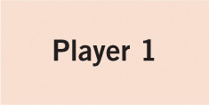
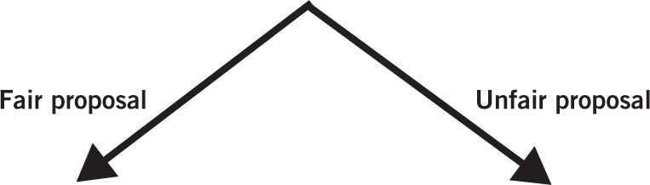
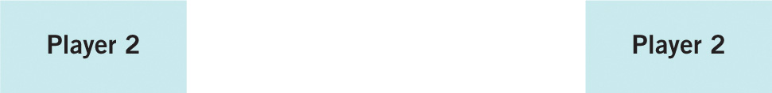
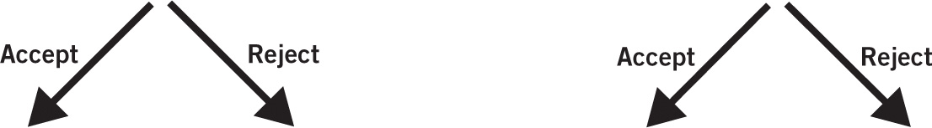
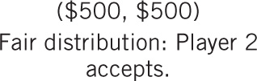

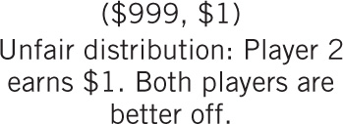
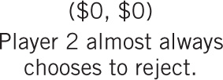
The Ultimatum Game, Illustrated
Notes:
Image: Animated Figure 17.1
Lecture notes:
First, show the game theory solution, then explain experimental results.
First click – Seventh click:
Draws the game tree step by step.
We will solve this game using backwards induction like you learned in Chapter 13.
Start with Player 2’s choice on the left.
Their best response is to Accept the proposal since they get $500 > $0.
Eighth click:
Draws a line through Reject branch.
Now look at Player 2’s choice on the right.
Their best response is to Accept since $1 > 0.
Ninth click:
Draws a line through Reject branch.
Now, go to Player 1’s choice. Looking forward he can make a Fair Proposal and get $500 or make an Unfair Proposal and get $999.
Therefore, he makes the Unfair Proposal.
Tenth click:
Line through Fair Proposal.
So, if both players act according to the standard rational choice model we get: {Unfair Proposal, Accept}
What happens when people actually play the game?
Eleventh click:
Uncovers the results.

Slide 28
Ultimatum Game Results
Economic theory of rationality will tell us that Player 2 should accept the unfair proposal.
  But real Player 1s rarely offer really low amounts, and often offer equal splits
  And real Player 2s often reject offers that are “too low”
What’s going on?
Notes:
Lecture tip: This is tied to the game from the beginning of this presentation.
Lecture notes:
On Player 1:
Offers “fair” amount because they want to be “fair” or they fear that Player 2 will reject offer that they think is “unfair.”
On Player 2:
The more “unfair” the proposal is, the more likely the rejection.
$999-to-$1 split may be rejected quite often. However, a $600-to-$400 to split may not be rejected very often.
Note that different dynamics of cooperation can develop if the game is played more than once. If the game is played repeatedly, (especially if player 1 and player 2 switch roles), a strategic cooperation will most likely develop.

Slide 29
Economics in “Superfreakonomics”
John List offers a twist on the Ultimatum Game.
Notes:
“Economics in the Media” Slide
Lecture tip:
The clip mentioned on the slide can be found in the Interactive Instructor’s Guide. Access the direct link by clicking the icon in the PowerPoint above.
Depending on the motivations in the Ultimatum Game, the Dictator Game is a nice addition.
The key concepts covered in this clip are:
Behavioral economics
Altruism
Ultimatum game
Dictator game

Slide 30
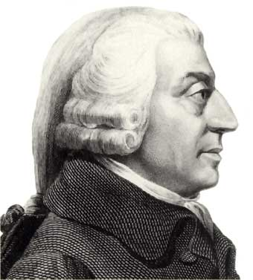
THE TWO FACES OF ADAM SMITH—1
“It is not from the benevolence of the butcher, the brewer, or the baker that we expect our dinner, but from their regard to their own interest. We address ourselves, not to their humanity but to their self-love, and never talk to them of our own necessities but of their advantages.” (WN)
Notes:
“Beyond the Book” Slide
The following two quotes come from The Wealth of Nations and The Theory of Moral Sentiments.
Smith on our “social” motives.

Slide 31
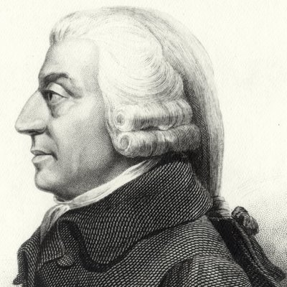
THE TWO FACES OF ADAM SMITH—2
“How selfish soever many may be supposed, there are evidently some principles in his nature, which interest him in the fortune of others, and render their happiness necessary to him, although he derives nothing from it except the pleasure of seeing it” (MS)
Notes:
“Beyond the Book” Slide
The following two quotes come from The Wealth of Nations and The Theory of Moral Sentiments.
Smith on our “social” motives.

Slide 32
Practice What You Know—1
What is an explanation for bounded rationality (also called limited reasoning)?
  People like to take risks.
  People often have incomplete information and limited decision-making time.
  People really are not concerned with utility maximization.
  People don’t know their own preferences.
Notes:
Clicker question:
Correct answer: B, People often have incomplete information and limited decision-making time.
Without perfect information and enough time to analyze all choices, we can’t be “fully” rational.

Slide 33
Practice What You Know—2
A flipped coin lands on heads five times in a row. Jaime believes the sixth flip will almost certainly land tails. Jaime is showing an example of:
  bad decision making.
  imperfect information.
  the hot hand fallacy.
  the gambler’s fallacy.
Notes:
Clicker question:
Correct answer: D, the gambler’s fallacy.
The gambler’s fallacy is the belief that outcomes that have not occurred recently are more likely to occur soon.

Slide 34
Practice What You Know—3
The ultimatum game shows that people care about:
  fairness of payoffs.
  only their own payoffs.
  long-run payoffs.
  certainty of payoffs.
Notes:
Clicker question:
Correct answer: A, fairness of payoffs.
In the game, perceptions of fairness are important. Player 2 punishes Player 1 for choosing an unfair offer, even it means lowering his own payoffs.

Slide 35
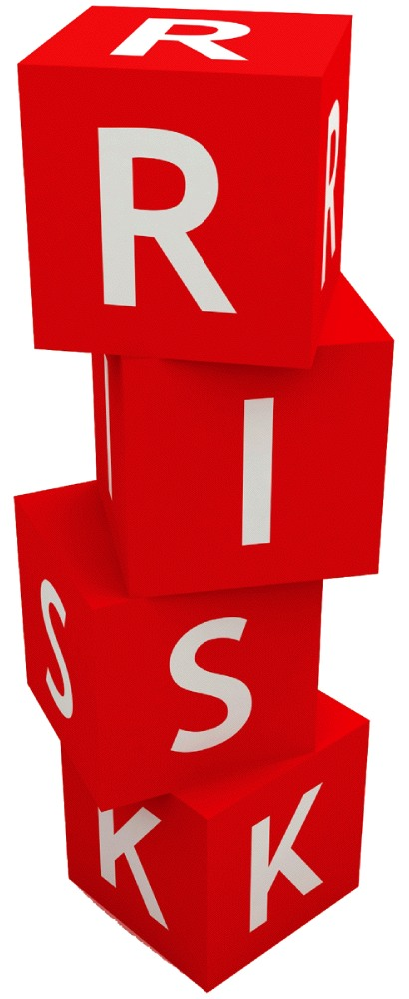
What Is the Role of Risk in
Decision Making
Two main ideas:
  Preference reversal
    Occurs when people’s risk tolerance is not consistent
  Prospect theory
    People weigh the utilities and risks of gains and losses differently
Notes:
Alex Slobodkin/iStockphoto.com

Slide 36
Preference Reversals—1
Risk-averse person
  Prefers a certain payoff to a gamble with a higher expected value
Risk-neutral person
  Chooses the highest expected value regardless of the risk
Risk-loving or risk-taking person
  Prefers gambling with lower expected values (but potentially higher winnings) over a certain payoff
Notes:
Lecture notes:
An example:
Suppose a coin-flip game involves the following.
Heads: You win $100.
Tails: You get nothing.
The expected value of this game is $50.
How much guaranteed money would it take you to not play the game?
A risk-averse person would take a guaranteed payoff of less than $50 and choose not to play.
For example, you could ask the risk-averse person to play or get a guaranteed $35.
Depending on the level of his risk aversion, he would most likely take the $35 and not play, even though $35 is less than the expected value of the game.
A risk-neutral person would require a guaranteed payoff of $50 (or greater) and choose not to play.
The risk-neutral person would be indifferent between playing and the guaranteed $50.
Any guaranteed offer greater than $50 would cause the person to take the offer and not play.
A risk-loving person would take a guaranteed payoff of greater than $50 and choose not to play.
For example, you could ask the risk-loving person to play or get a guaranteed $60.
Depending on the level of his risk-loving nature, he would most likely rather play instead of take the $60, even though $60 is greater than the expected value of the game.

Slide 37
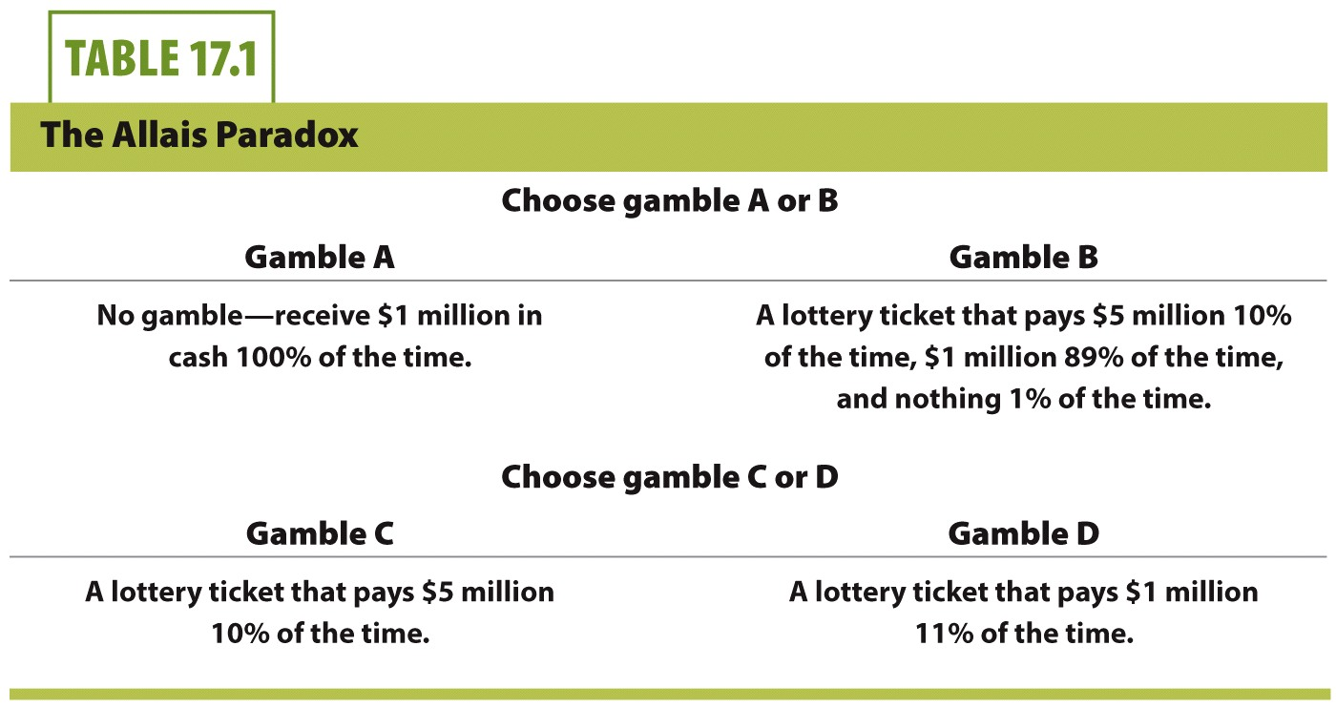
Allais Paradox—1
Notes:
Lecture tip:
Ask students to make a choice between Gamble A and Gamble B. Make sure they understand that there is no “right” answer since which gamble they choose depends on their own risk preferences.
First click:
Uncovers Gamble C and D.
Query students again.

Slide 38
Allais Paradox—2
Risk-averse person
  Will choose A over B (sure thing is better)
  Will choose D over C (higher probability of win)
Notes:
Lecture tip:
Discuss what people with different risk preferences should do.

Slide 39
Allais Paradox—3
Risk neutral
  Will choose B over A (higher expected value)
  Will choose C over D (higher expected value)
Notes:
Lecture tip:
Discuss what people with different risk preferences should do.

Slide 40
Allais Paradox—4
Risk-taking person
  Will choose B over A (higher risk)
  Will choose C over D (higher risk)
Notes:
Lecture tip:
Discuss what people with different risk preferences should do.

Slide 41
Allais Paradox—5
Allais’ results
  Approximately 30% of the population selected a contrasting set of pairs of gambles, A and C.
Notes:
Lecture tip:
Explain why this is inconsistent.

Slide 42
Preference Reversals—1
Illustrates preference reversal.
Why does this occur?
  Risk tolerance depends on financial circumstances
  People who gamble (risk loving) are more likely to participate in large-prize games such as lotteries, because large prizes will greatly improve their lives.
  People care about how much they could win and how much they stand to lose.

Slide 43
Preference Reversals—2
Another example: Tax refunds
  80% of people expect a tax refund due to overpaying taxes.
  Why is this odd?
  But what’s even odder …
Notes:
Lecture notes:
Why odd?
We assume that people typically have strongly positive time preferences: they want it sooner rather than later.
People who wait to receive their money later are said to have a weakly positive time preference.
Note they could easily solve the problem by having less taken out of their paycheck.
What’s odder?
When people file their taxes and expect a refund, they pay a fee to get the refund quicker.

Slide 44
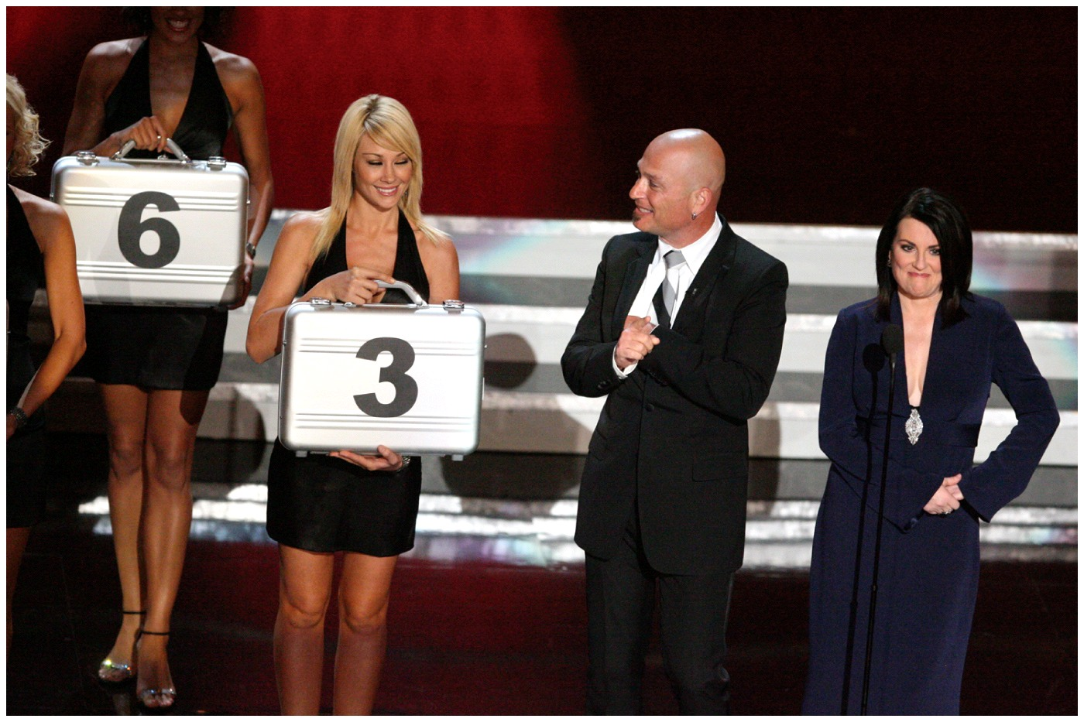
Prospect Theory—1
Prospect theory
  Individuals place more emphasis on gains than losses.
  Implies that people evaluate the risks that lead to gains separately from the risks that lead to losses
Notes:
[Jason Merritt/FilmMagic/Getty Images]

Slide 45
Prospect Theory—2
When does this happen?
  Games of chance (not skill). In Deal or No Deal, contestants who have a rough start take more risks later in the game.
  Investing. Investors try to make up for losses by taking more chances later rather than calculating expected values.
  Mundane everyday human behavior. Setting your clock 10 minutes fast so you’re not late. Standard theory says you would never try to fool yourself.
Notes:
Lecture notes:
Prospect theory:
Daniel Kahneman and Amos Tversky suggest that individuals place more emphasis on gains than losses.
This implies that people evaluate the risks that lead to gains separately from the risks that lead to losses.
This result is useful because it tells us why some investors try to make up for the losses they have experienced by taking more chances later instead of seeking to maximize the utility they receive from money under a rigid calculation of expected value.
Armed with this knowledge, we can explain a wider range of human reactions, even extending into everyday behavior.

Slide 46
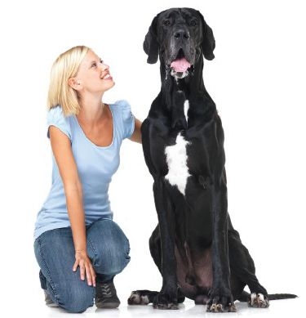
Economics for Life: How to Guard Yourself Against Crime
Why is a “Beware of Dog” sign an effective low-cost way to protect your home from burglars?
  Burglars are bounded rational.
  Burglar has incomplete
  information so will move on
  to an easier target.
Notes:
[© Yuri Arcurs | Dreamstime.com]

Slide 47
Practice What You Know—4
Loss aversion tends to cause people to:
  ignore wins completely and only focus on the negative effects of losses.
  behave too conservatively and not take enough risks.
  gamble only when they can afford to play.
  live boring lives.
Notes:
Clicker question:
Correct answer: B, behave too conservatively and not take enough risks.
Loss aversion exists when individuals place more weight on avoiding losses than attempting to realize gains.

Slide 48
Practice What You Know—5
Which of the following statements is true about risks, risk taking, and risk preference?
  Risk preferences vary among different people.
  Risk-averse people will never engage in an activity with an uncertain outcome.
  All activities involve probability and risk.
  People never change their risk preferences.
Notes:
Clicker question:
Correct answer: A, Risk preferences vary among different people.
Some people (probably most people) are risk averse. Others are risk loving or risk neutral.

Slide 49
Conclusion
Behavioral economics questions the traditional economic model and invites a deeper understanding of human behavior
  Rationality treated as a basis of some but not all decisions
  Recognizes psychological barriers and biases
  Examines risk preferences and changes in these preferences in different circumstances

Slide 50
Just for Fun—1.A
Read the following sentence out loud. As you read, count how many “F”s there are.
Ready?
FINISHED FILES ARE THE RESULT OF YEARS OF SCIENTIFIC STUDY COMBINED WITH THE EXPERIENCE OF YEARS.
Notes:
Lecture tip:
You could use clickers for the next set of slides (50-56), but it’s just as easy to have students jot down their answers to the questions.
The point of the next set of slides is partly for fun, but also to show that we have limited cognitive ability, which may lead us to make decisions that are less than rational. You can also refer to some of them later in lecture.
Make sure the class reads the sentence out loud. I can’t hear you!!
Once they have read it one time, have them do it again.

Slide 51
Just for Fun—1.B
How many F’s did you get?
  Raise your hand if you got 3.
  Raise your hand if you got 6.
  Did anyone get a different number?
FINISHED FILES ARE THE RESULT OF YEARS OF SCIENTIFIC STUDY COMBINED WITH THE EXPERIENCE OF YEARS.
Notes:
Lecture tip:
Do a rough count of the threes and sixes. If your class is consistent with previous results, a little more than one-third will find three and a little more than a third will find six. You will get some strange answers.
The reason for the difference should be fairly obvious (or not, since I got three the first time). When you say count the Fs, most people count the “Effs” and ignore the “V” sound in OF.

Slide 52
Just for Fun—2
Suppose you and four classmates have just won $2 million in the lottery. How much do each one of you get, assuming you share the $2 million equally?
Suppose you put $200 in a savings account. If the annual interest rate is 10%, how much money do you have after two years?
  $220
  $240
  $242
  $250
Notes:
Lecture notes:
Answer:
#1: $400,000.
#2: (C)
Both of these questions came from a survey given by Goldman Sachs to some of their investor clients. About a fourth of those asked missed the first question. Fewer than half those asked got the second question correct.

Slide 53
Just for Fun—3.A
Suppose you are a dragon slayer. Queen Morgana has asked for your help to slay a dragon that has been attacking her lands. It will take you exactly 30 days to take out the dragon. Queen Morgana offers you a choice of the following two contracts.
  You will be paid $100,000 per day until you get rid of the dragon.
  You will be paid 1 cent on the first day, 2 cents on the second day, 4 cents on the third day, and so on until you kill the dragon.
  Which contract do you choose?
Notes:
Lecture tip:
After giving students the two contracts, remind them that it will take them 30 days to kill the dragon.
The answer is revealed on the next slide.

Slide 54
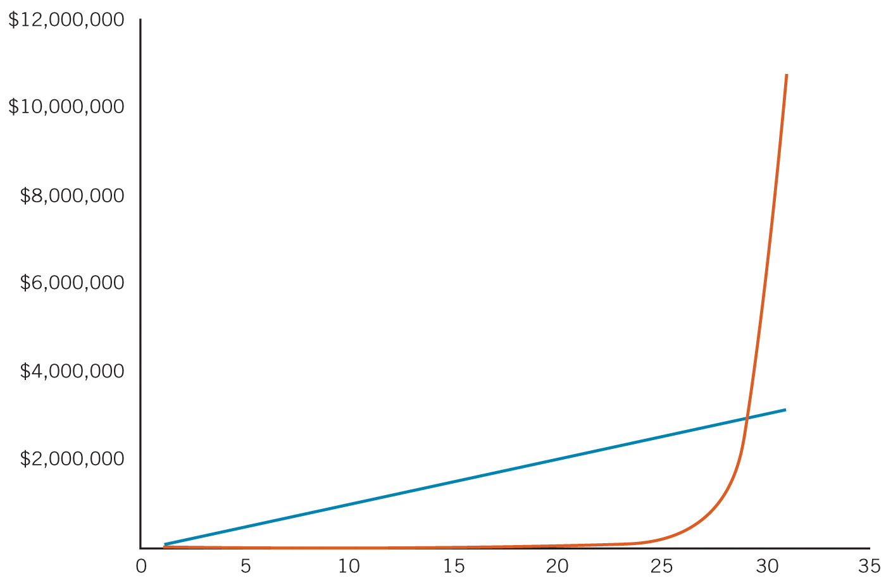
Just for Fun—3.B
Queen and the Dragon Slayer
Notes:
Lecture notes:
You can earn either $3 million or you can earn $10.7 million.
Most people can calculate the $3 million, but rarely come close to getting $10.7 million. They can’t imagine that a penny doubled each day for 30 days could ever get above $3 million.

Slide 55
Just for Fun—4.A
Outbreak of a disease will cause 600 deaths in the United States. Two mutually exclusive programs are expected to yield the following.
A: 400 people will die
B: With probability 1/3, 0 people will die; with probability 2/3, 600 people will die.
C: 200 people will be saved
D: With probability 1/3, all 600 will be saved; probability 2/3 none will be saved.
Notes:
Lecture tip:
You can relate this back to the discussion on framing effects.
As each pair is presented, ask students which program they would choose. Point out that there is no right or wrong answer.
When the second pair is presented, a box covers the first pair.

Slide 56
Just for Fun—4.B
Outbreak of a disease will cause 600 deaths in the United States. Two mutually exclusive programs are expected to yield the following.
A: 400 people will die
B: With probability 1/3, 0 people will die; with probability 2/3, 600 people will die.
C: 200 people will be saved
D: With probability 1/3, all 600 will be saved; probability 2/3 none will be saved.
Notes:
Lecture notes:
This is a great example of the framing effect, which was discussed earlier.
Typical results:
Between A and B, a large majority (around 75 percent) choose B.
But between C and D, its roughly fifty-fifty.
Point out that A and C are the same in terms of the overall outcome, and B and D are the same in terms of the expected outcome.
So if you prefer B to A, then you should prefer D to C.
See if you can get a student(s) who reversed to explain why.

